Slide 1
REALIZATION OF PROTOTYPE MODEL OF PROCESS AUTOMATION SYSTEM USING RASPBERRY Pi

Slide 2
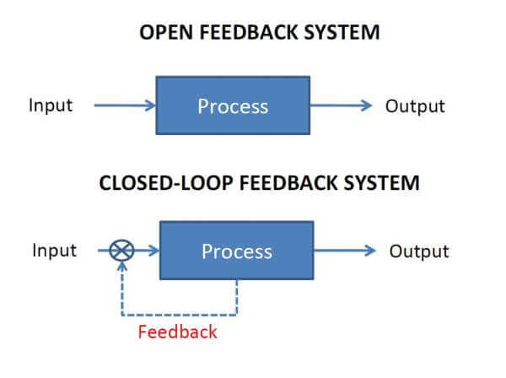
CONTROL SYSTEMS

Slide 3
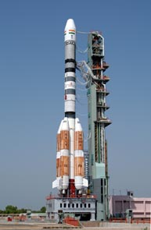

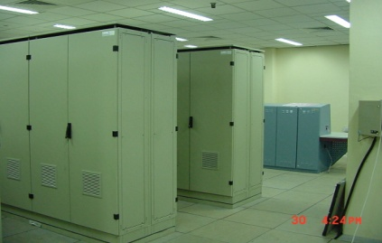
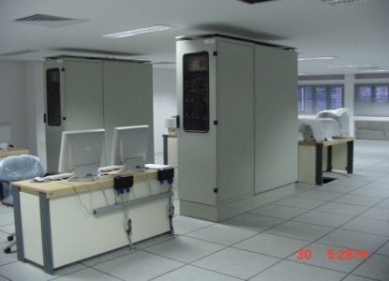

Process automation system in shar
Process
PLCs
Servers
Operator Consoles

Slide 4
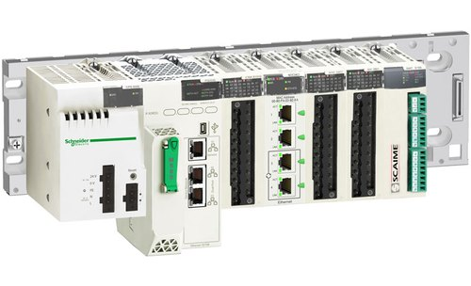
PLC
It is a small, Modular solid state computer with customized instructions for performing a particular task.
They are used in manufacturing plants or other automation environments.

Slide 5
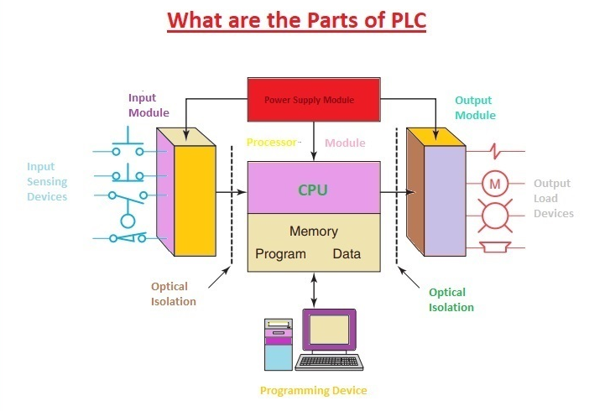

Slide 6
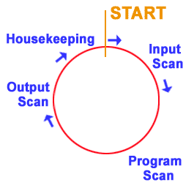
Plc Scan cycle
1. Input Scan
Scan the state of inputs.
2. Program Scan
Process the program logic.
3. Output Scan
Energize or de energizes the outputs.
4. Housekeeping
This step includes communications, Internal Diagnostics, etc.

Slide 7
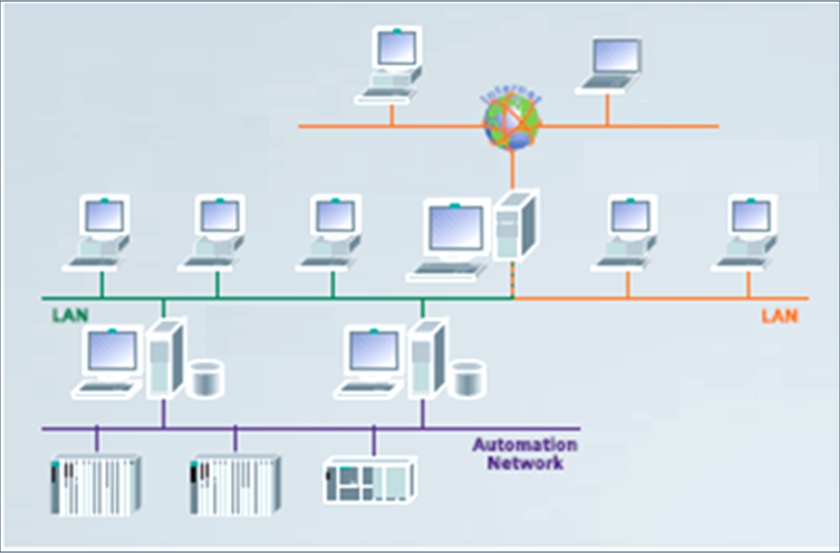
PLC OVERVIEW
SCADA Client + Web Server

Slide 8
plc
Analog inputs
Analog output
Flow Transducers
Temperature Transducers
Humidity Transducers
Pressure Transducers
Analog Valves
Actuators
Analog meters
Chart Recorder

Slide 9
PLC
DISCRETE INPUT
DISCRETE OUTPUT
Level Switches
Limit Switches
Proximity Switches
Push Buttons
Relay Contacts
Alarms
Control Relays
Solenoids
Valves

Slide 10
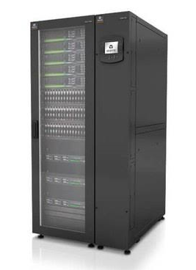
Server Rack
The Servers runs continuously so the generated heat may effect the working of the servers.
To avoid this internal AC is placed inside the Server racks
It maintains at temperature of 24ºC +1ºC
There will be an inbuild controller which detects the rise in temperature.
If the internal temperature rises more than the required then the doors will opens.

Slide 11
Project Title
REALIZATION OF PROTOTYPE MODEL OF PROCESS AUTOMATION SYSTEM USING RASPBERRY Pi
Objective :- To detect the rise in temperature of the server rack and open the door using Raspberry Pi controller

Slide 12
PROJECT
HMI
HMI
MODBUS
MODBUS
PLC
RPi
Serial
communication
TCP/IP
Sensor & RELAY
I/O

Slide 13
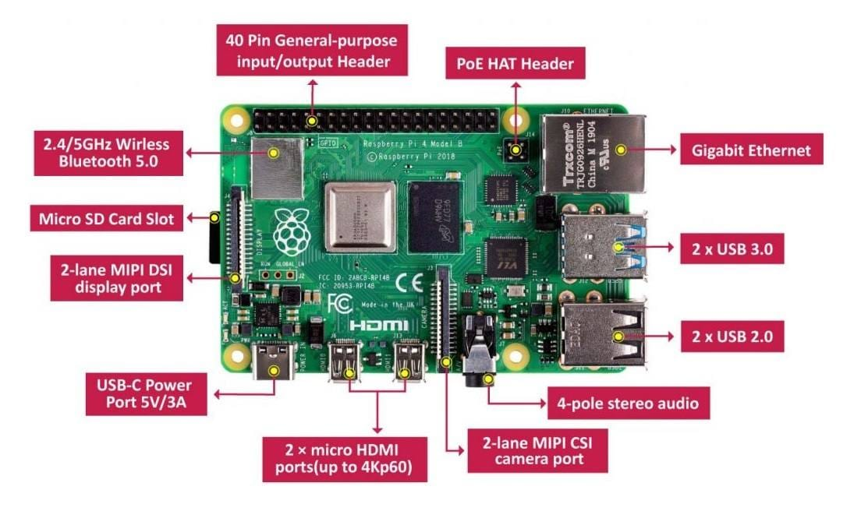
Raspberry Pi
Boardoom BCM2711, quardcoreCortex-A72(ARM v8) 64-bit soc @1.5 GHz
4GB memory
Opertaing temperature 0-50 C
Standard 40 pin GPIO Header

Slide 14
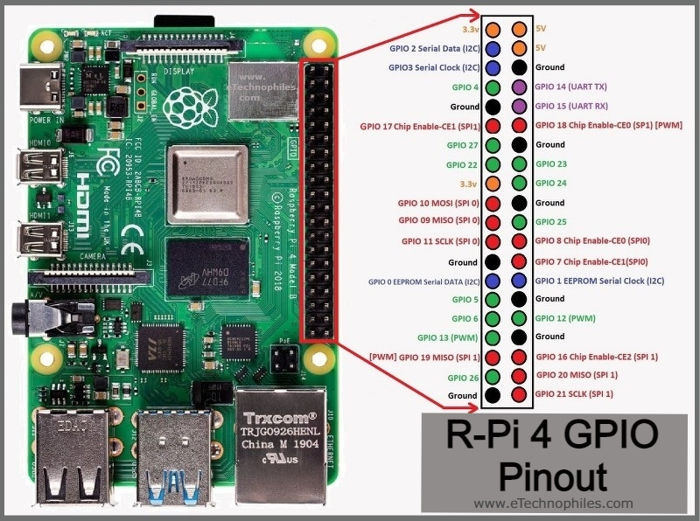
Raspberry Pi

Slide 15
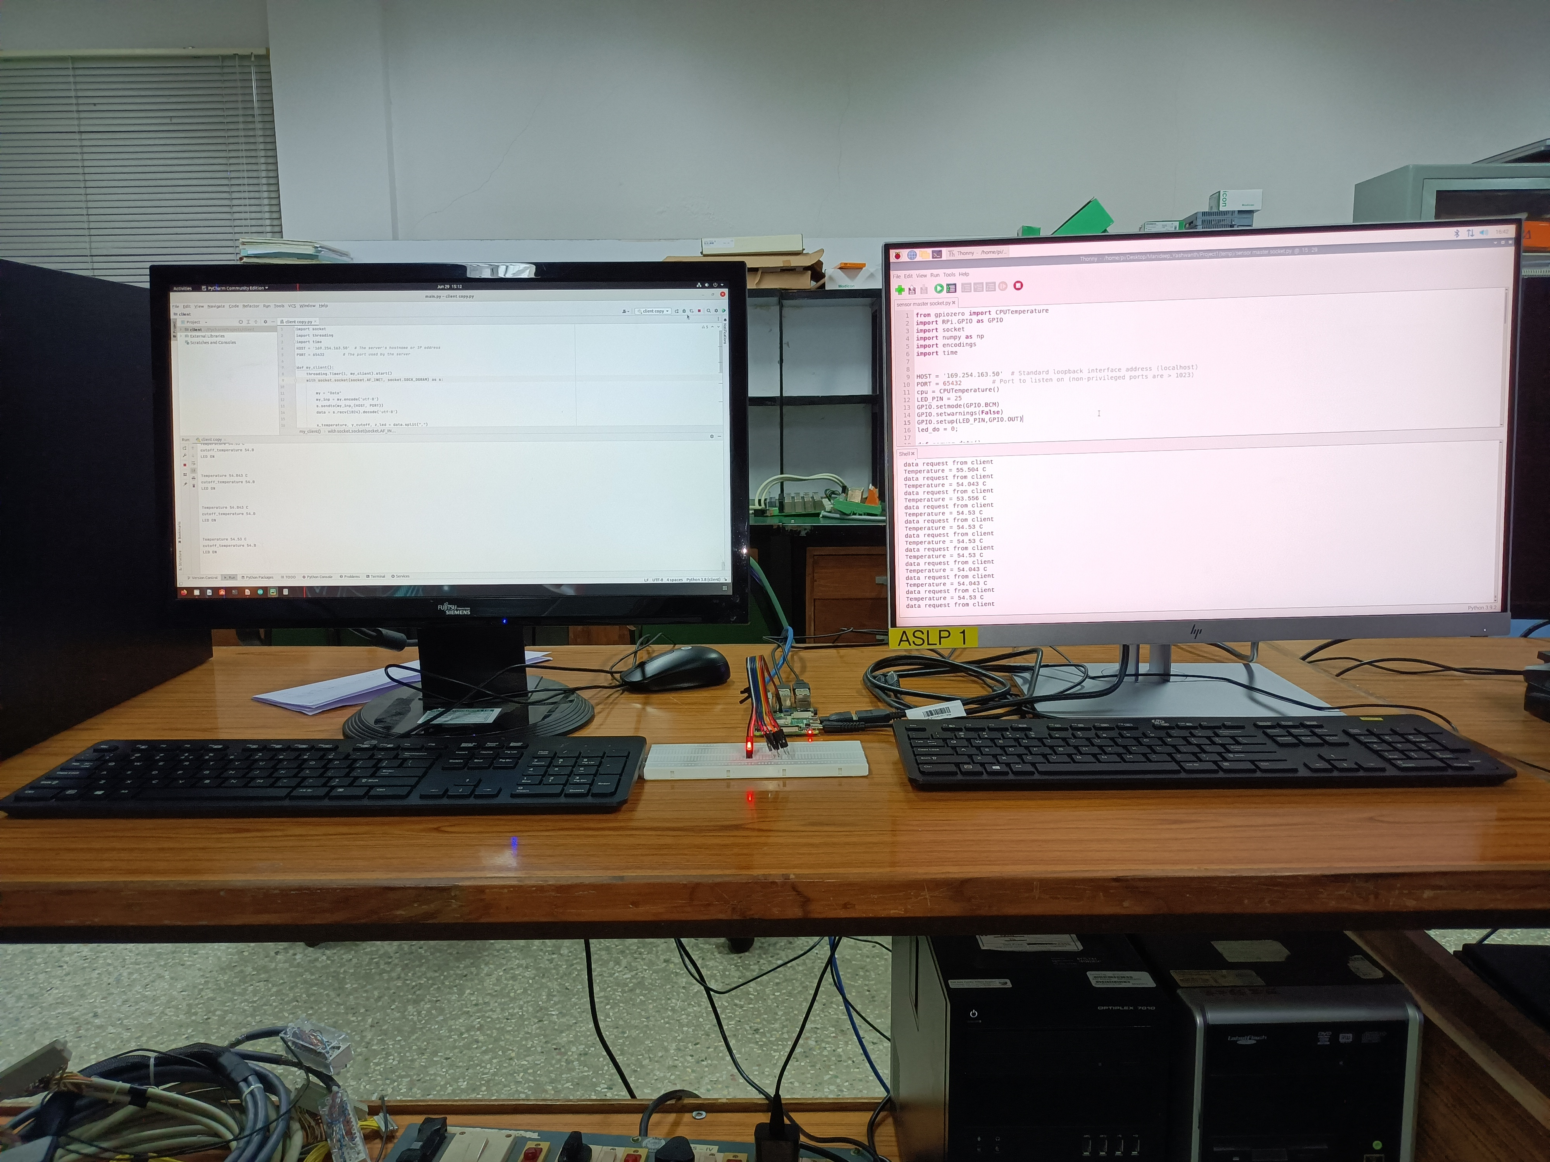
PROJECT
Here we established the communication between server and client system using Raspberry pi .
Here the client system receive the the data from the server through Raspberry pi.
The LED turns on when the RPi board temperature exceeds the threshold temperature.

Slide 16
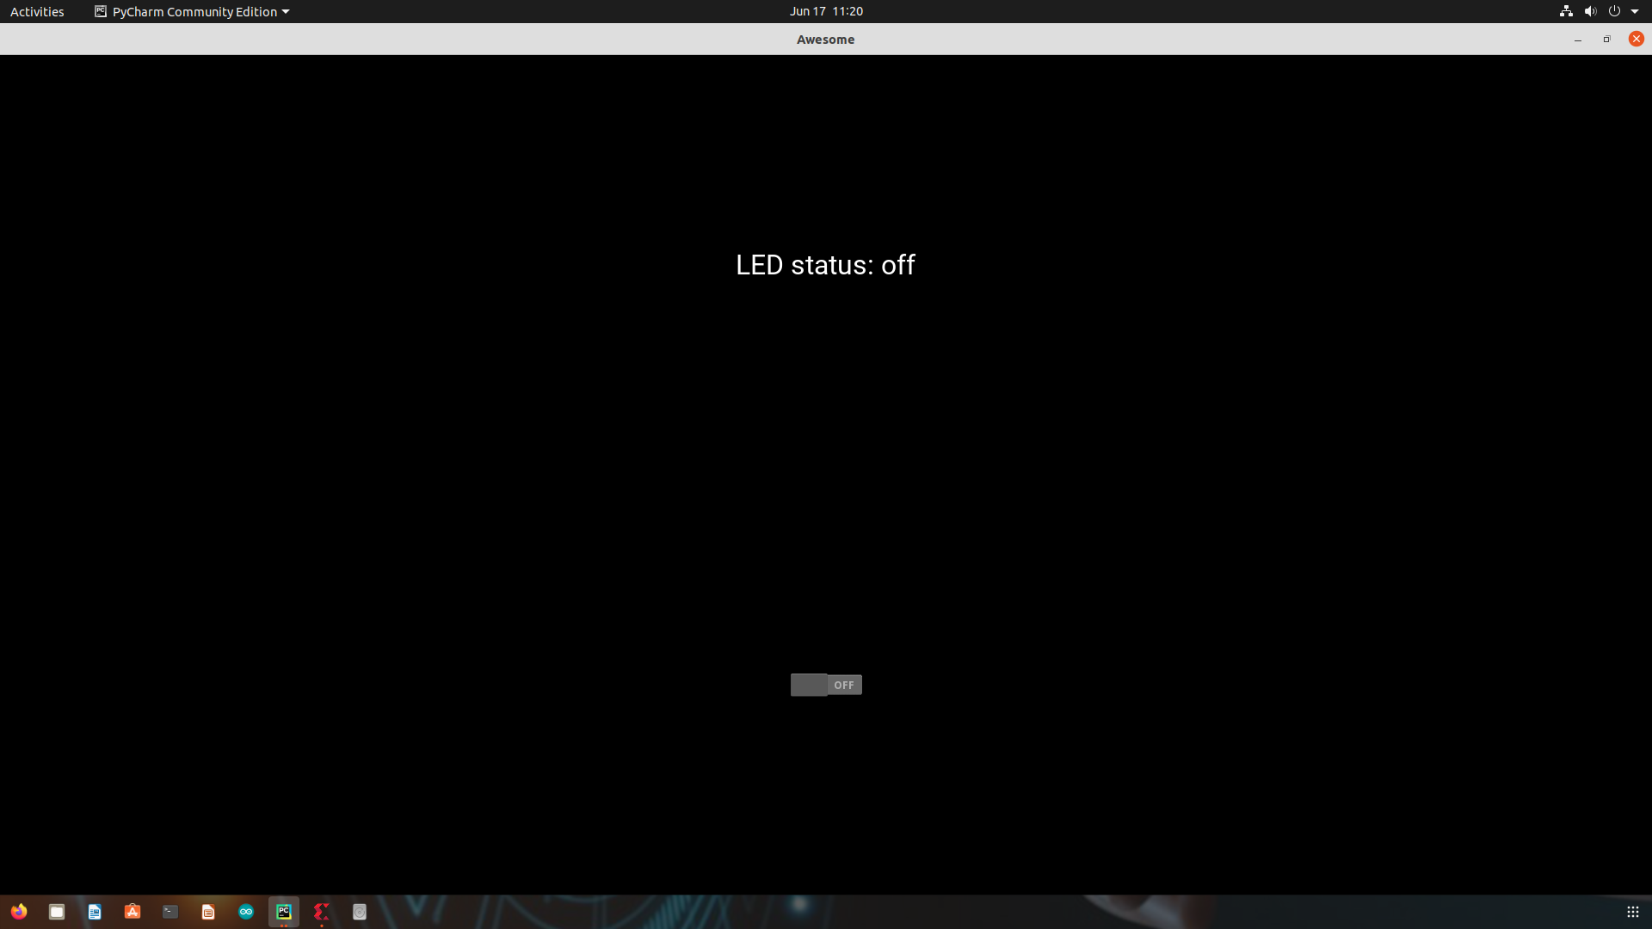
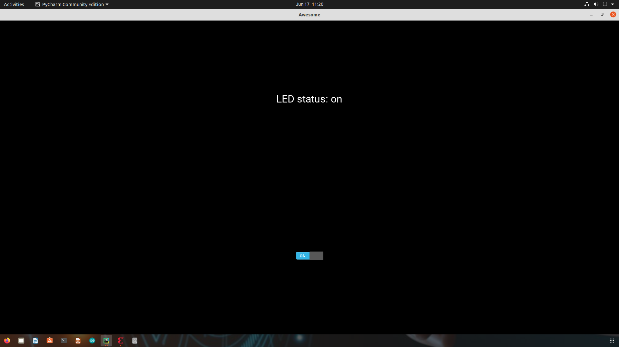
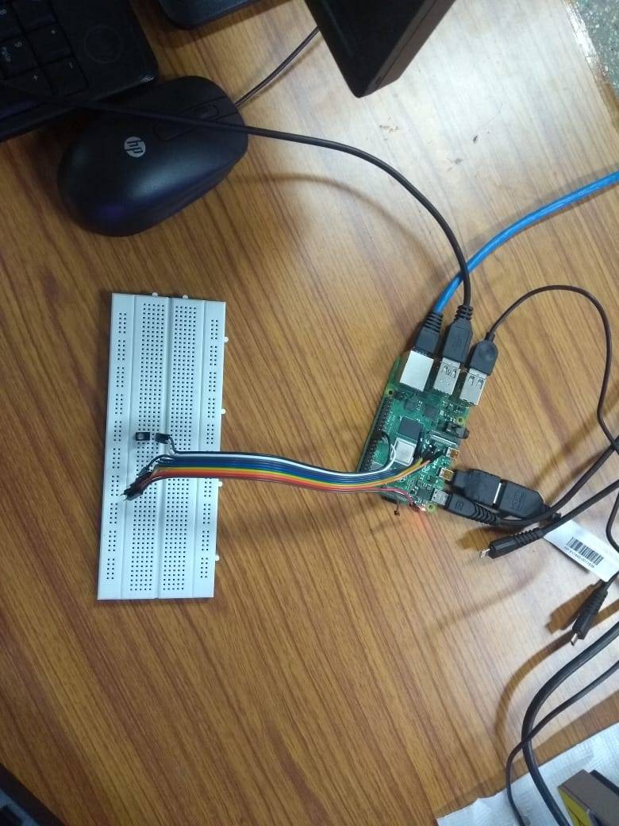
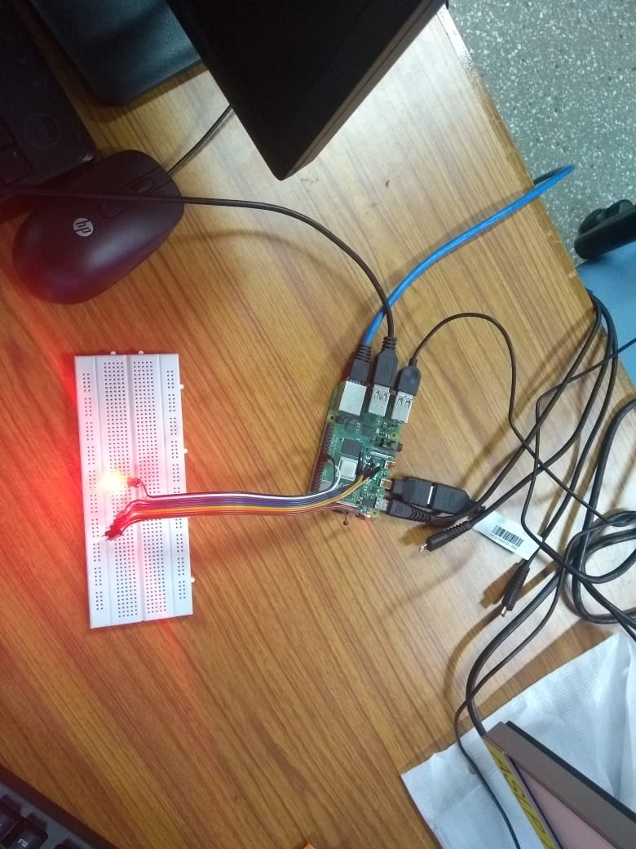
PROJECT

Slide 17
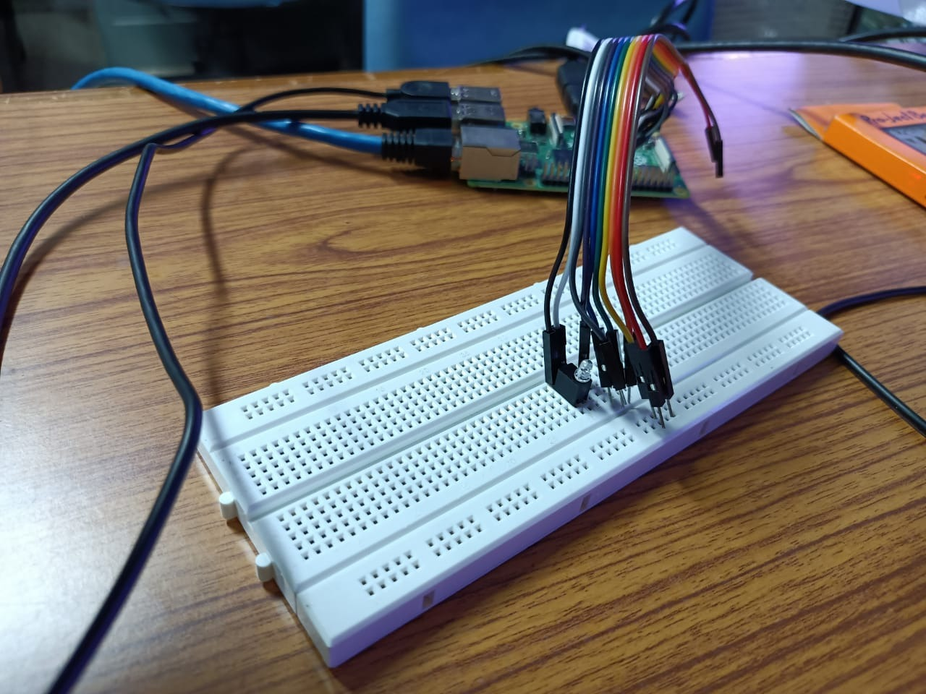
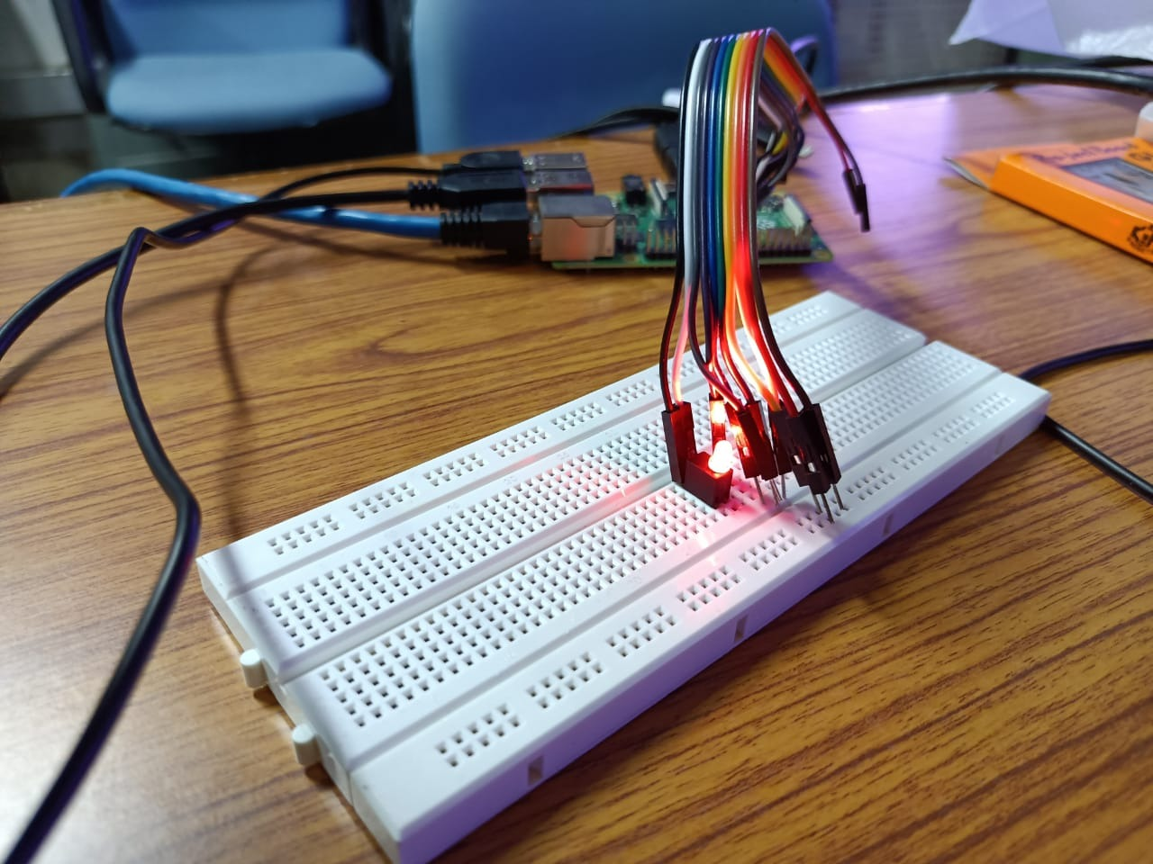
PROJECT
Result:-

